Slide 1
Status Report #17
2020. 03. 04 (Wed)
B4 FUJIWARA Tomomasa
B4 thesis presentation
ToF cosmic: t = 5 mm, w = 11 mm study
Bias dependence: V_{b} = 41.7 V, 44.7 V, 47.7 V

Slide 2
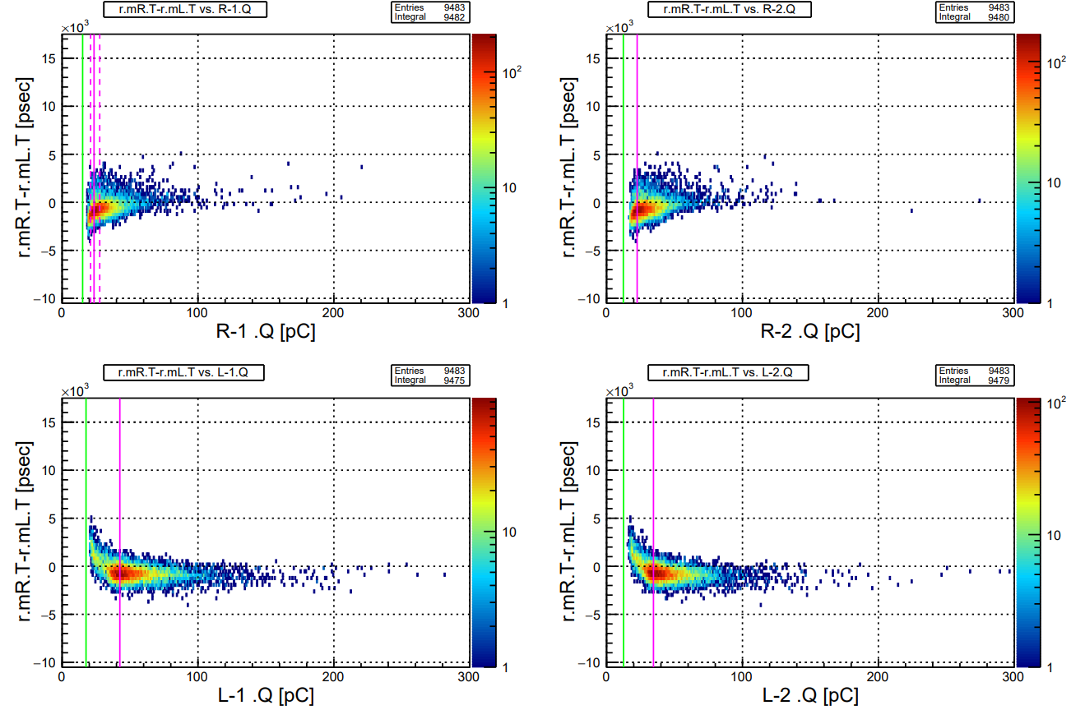
run061
Vb = 41.7 V
(Vop + 0.0 V)

Slide 3
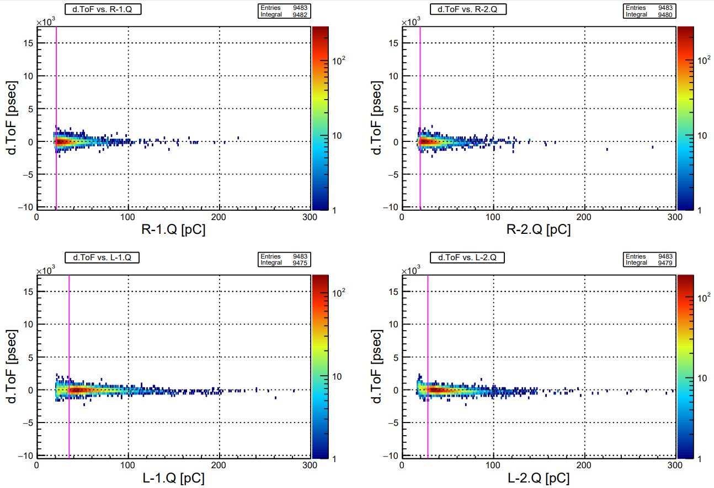
run061
Vb = 41.7 V
(Vop + 0.0 V)

Slide 4
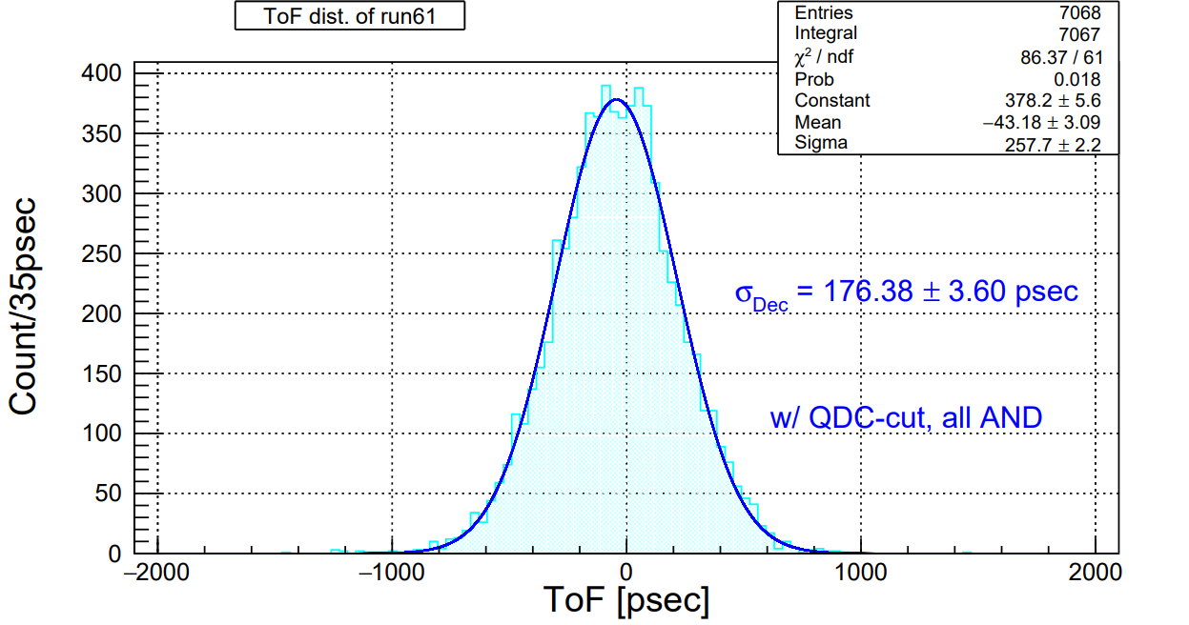
run061
Vb = 41.7 V
(Vop + 0.0 V)

Slide 5
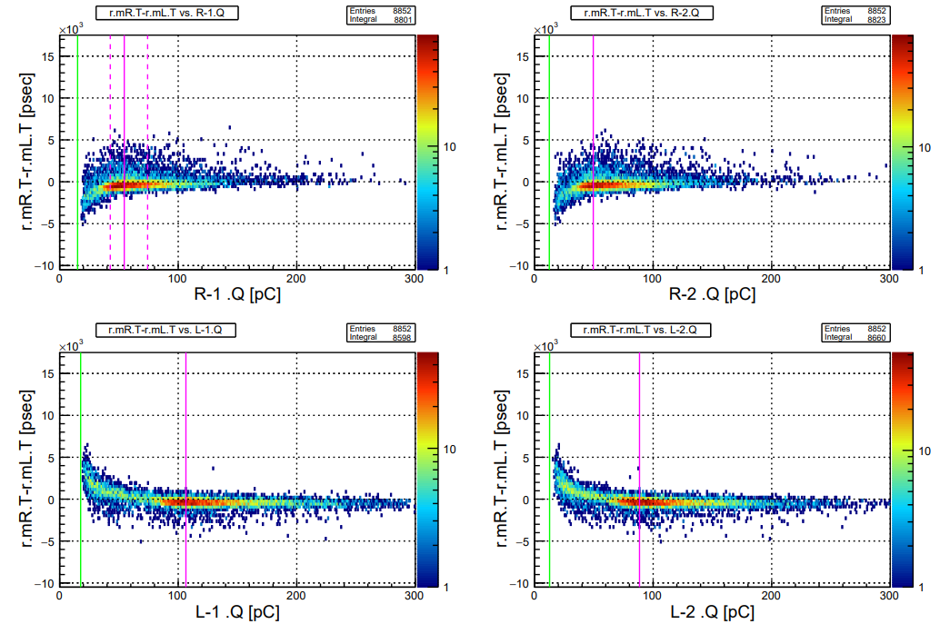
run063
Vb = 47.7 V
(Vop + 6.0 V)

Slide 6
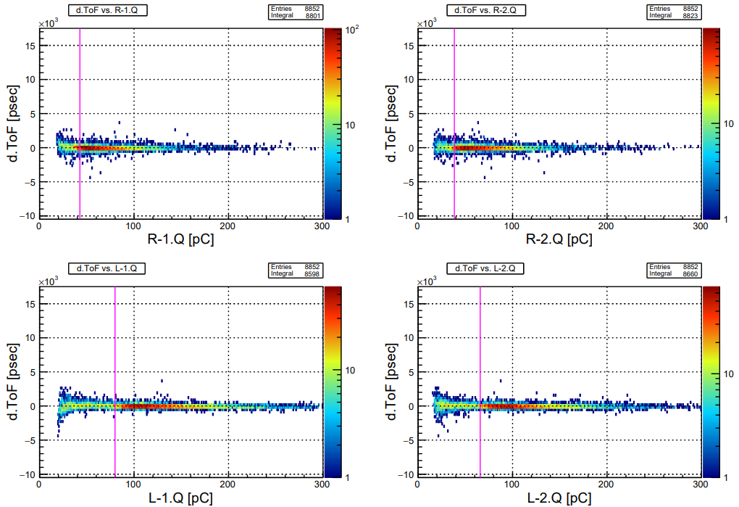
run063
Vb = 47.7 V
(Vop + 6.0 V)

Slide 7
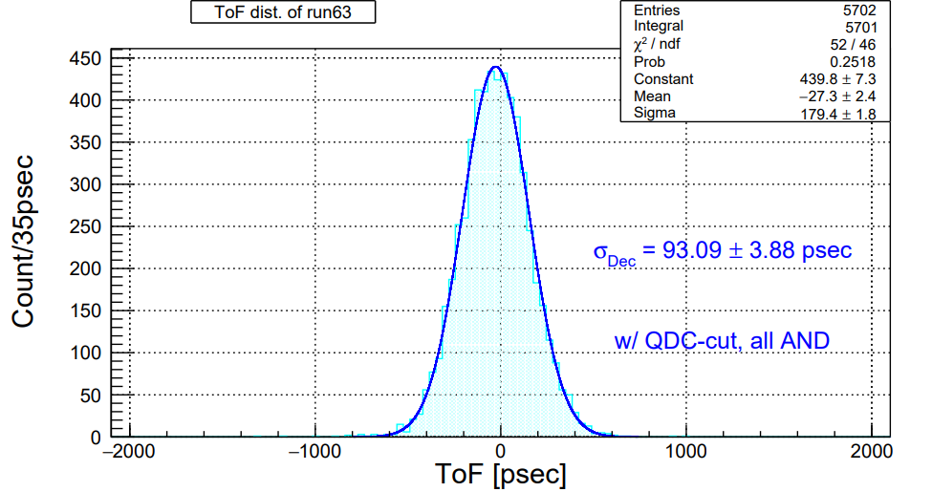
run063
Vb = 47.7 V
(Vop + 6.0 V)

Slide 8
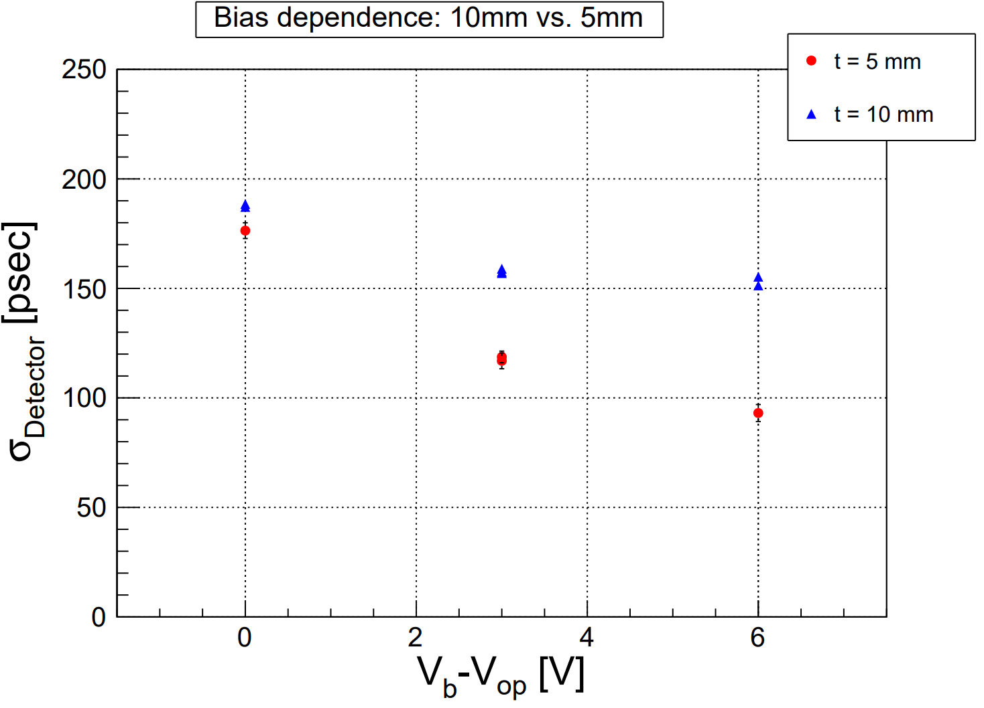
ToF cosmic: Bias dependence
ToF R: t = 5 mm, w = 11 mm
ToF L: t = 10 mm, w = 10 mm
V_{b}-V_{op} [V] = 0.0, +3.0, +6.0

Slide 9
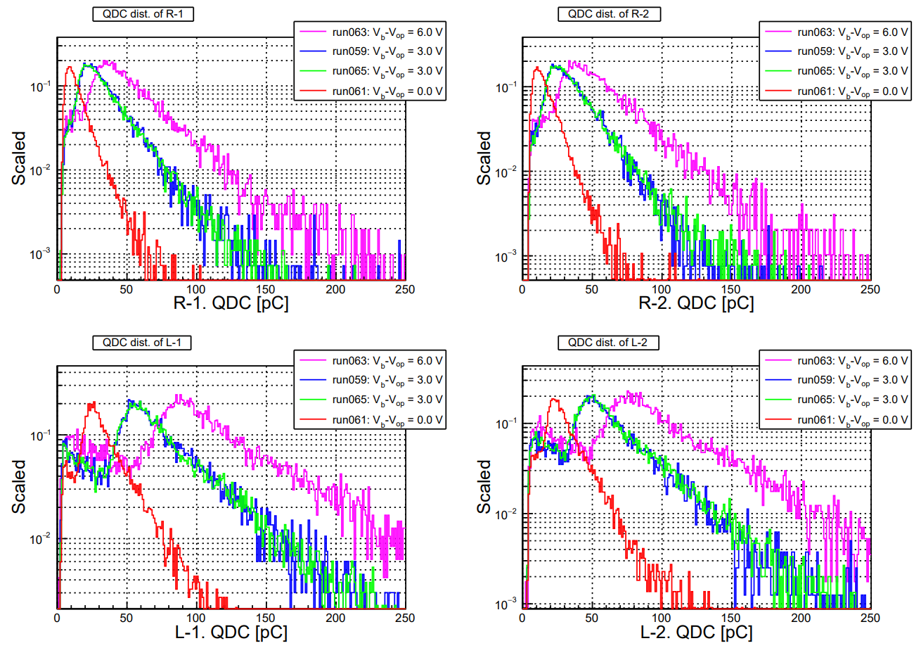
QDC distribution
Calibrated by pedestal = 0 pC

Slide 10
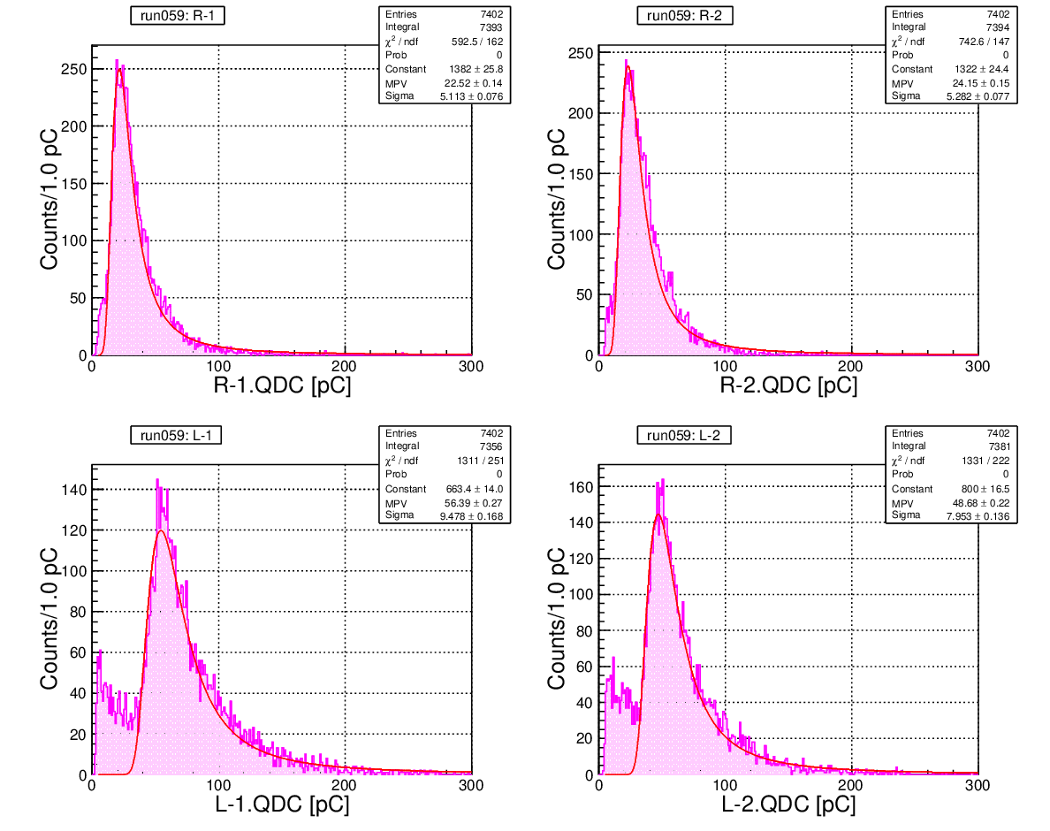
QDC distribution
Vb = 44.7 V
(Vop + 3.0 V)

Slide 11
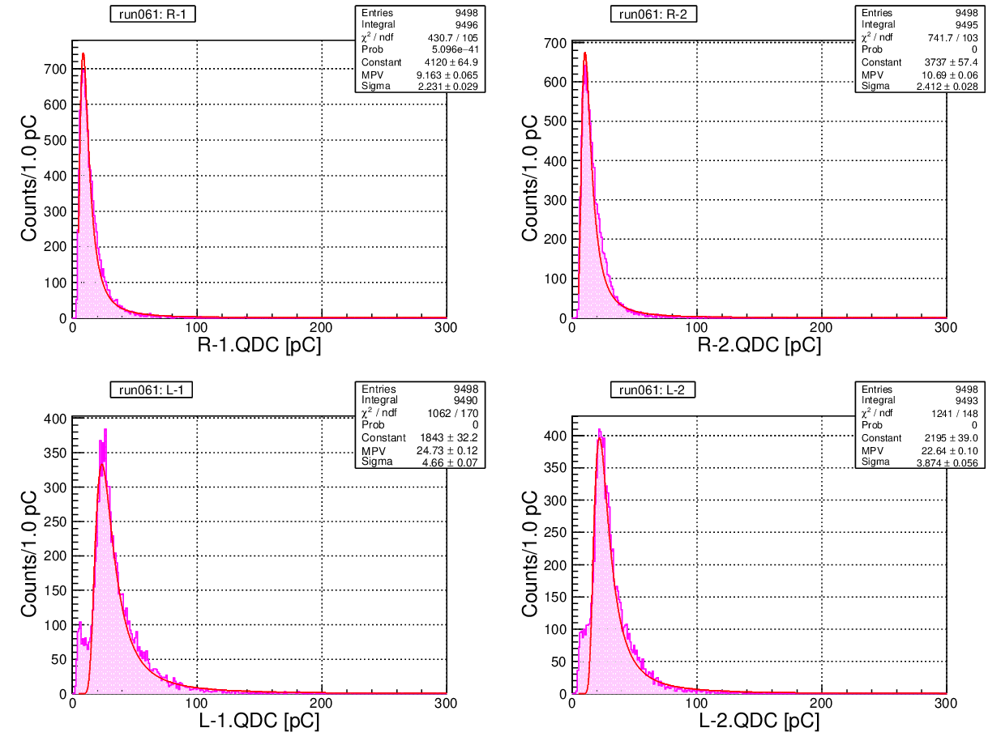
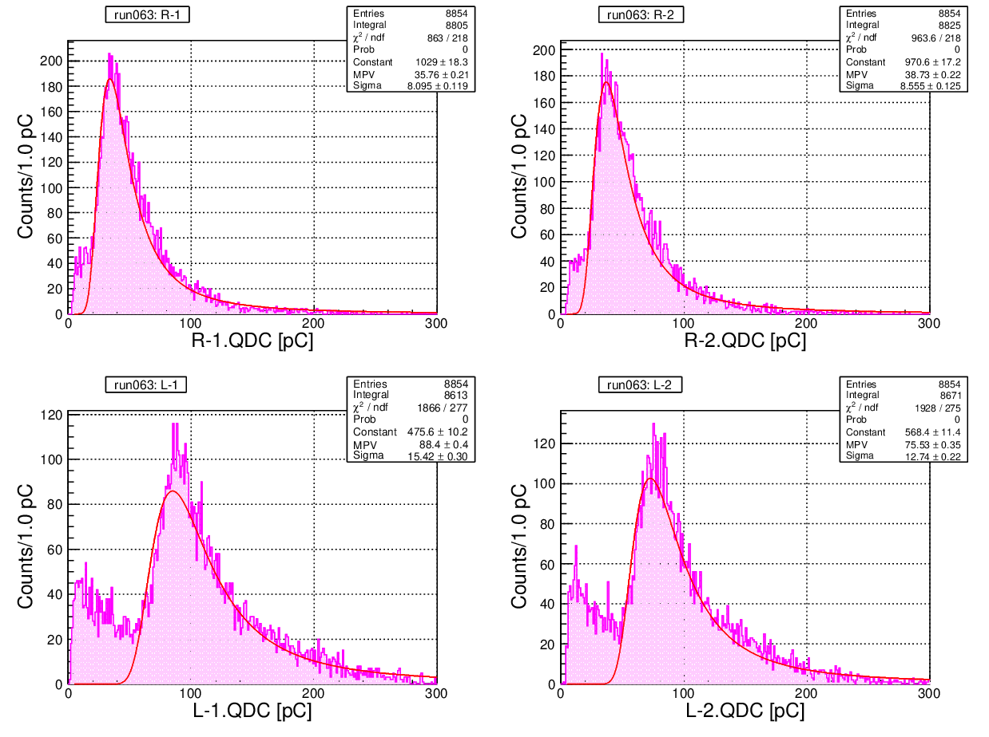
QDC distribution
Vb = 41.7 V (Vop + 0.0 V)
Vb = 47.7 V (Vop + 6.0 V)

Slide 12
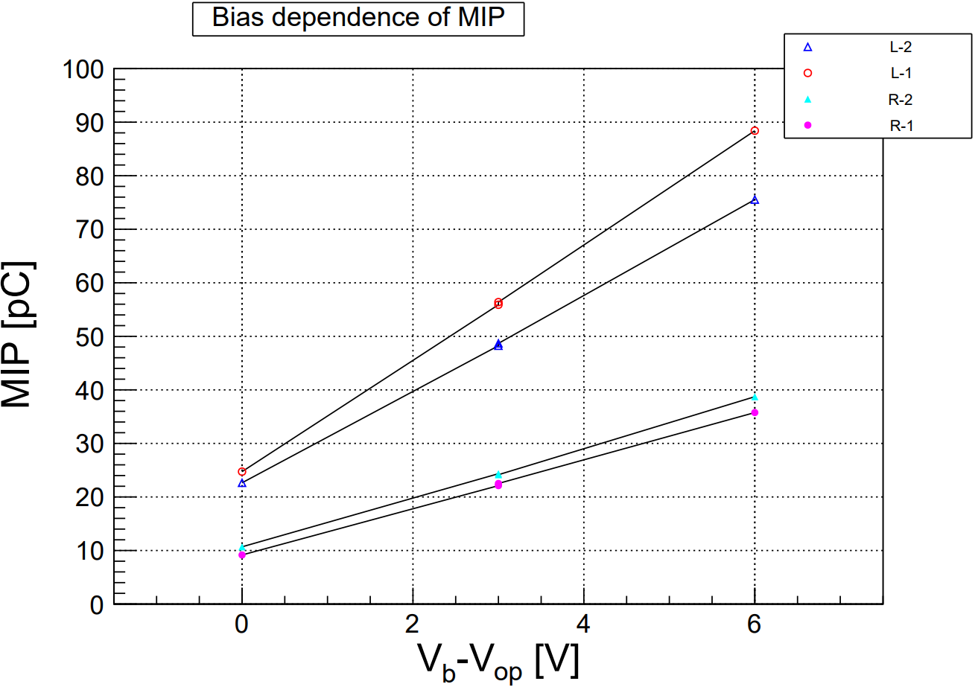
QDC distribution
MIP ⇒ MPV of Landau function
Bias dependence of MIP
Linear ?
同じシンチレータでも微妙な差
取付時の取り扱いの差 ?

Slide 13
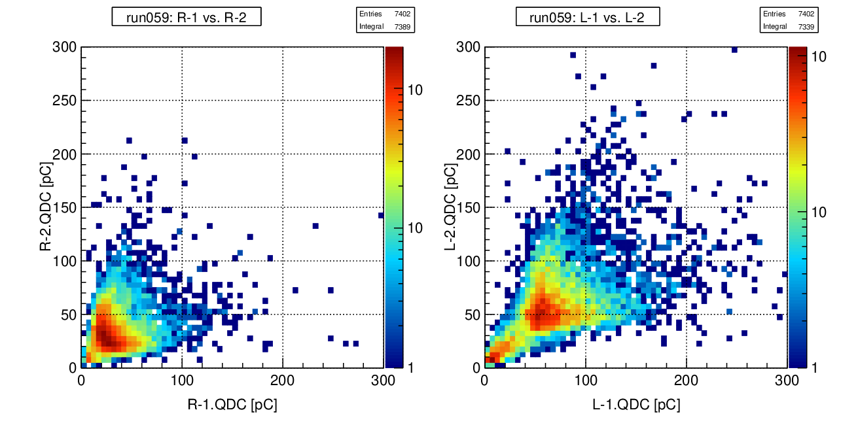
QDC distribution
2
2
Correlation of the same scintillator
Run059: V_{b} = 44.7 V

Slide 14
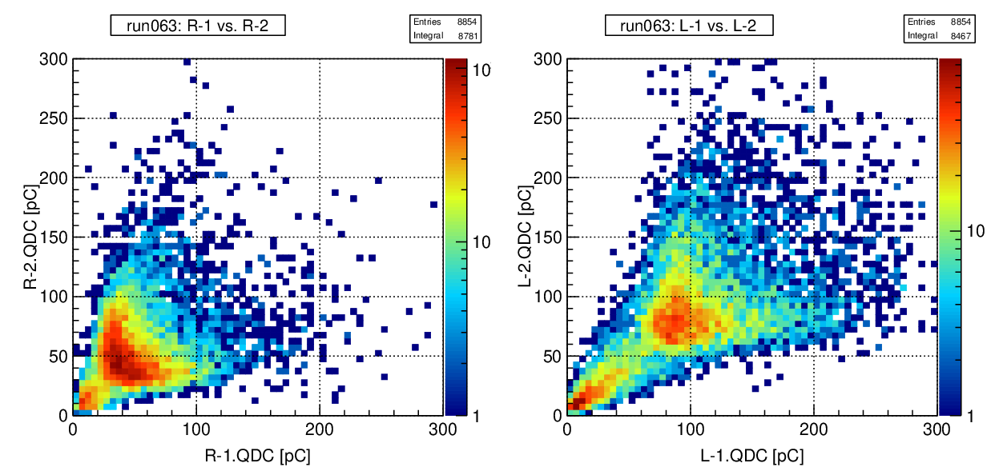
QDC distribution
Correlation of the same scintillator
Run063: V_{b} = 47.7 V
2

Slide 15
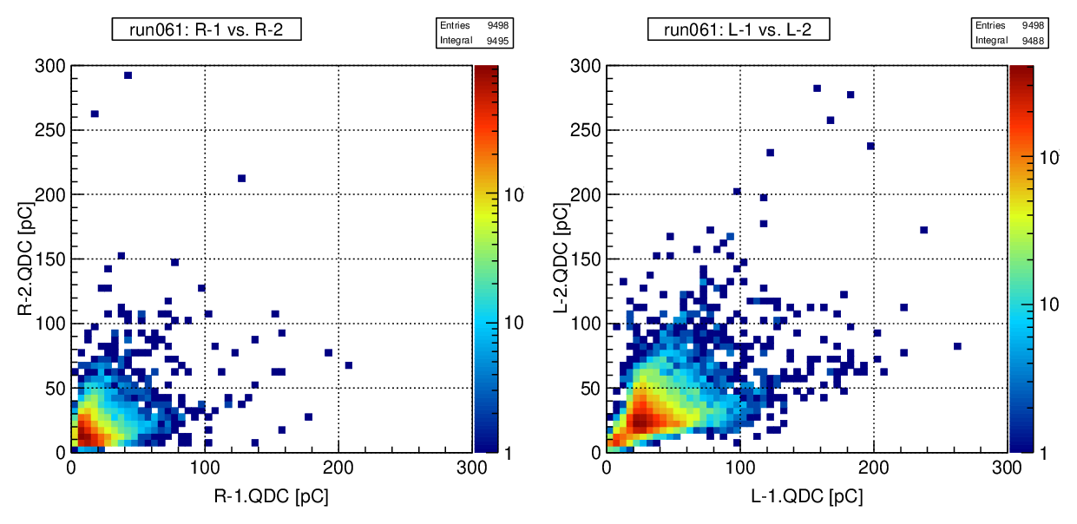
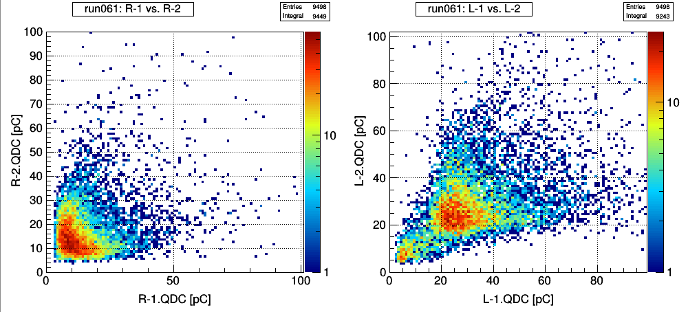
QDC dist.
Run061: V_{b} = 41.7 V
2
2

Slide 16
To do next
Test t=5 mm, w=22 mm scintillator & t=5 mm, w=44 mm scintillator
Making poster for JPS

Slide 17
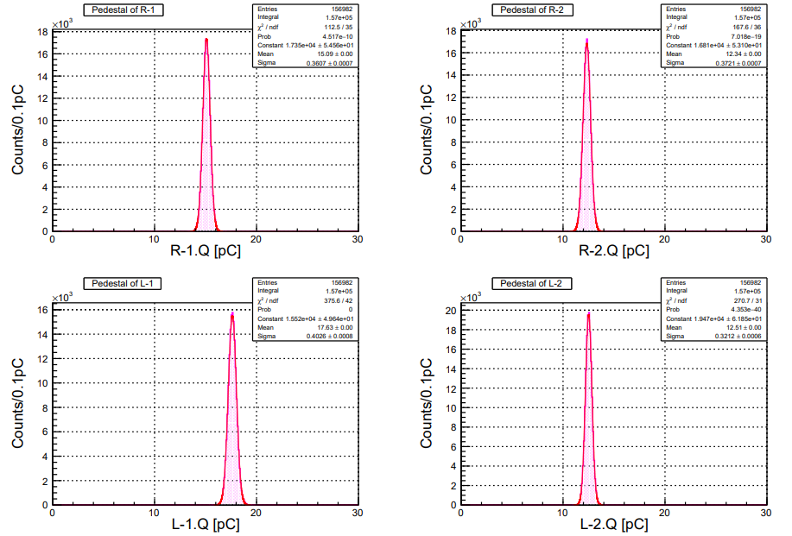
run059

Slide 18
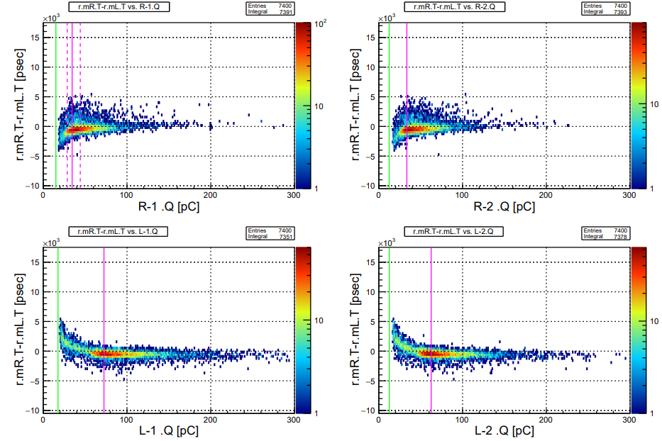
run059

Slide 19
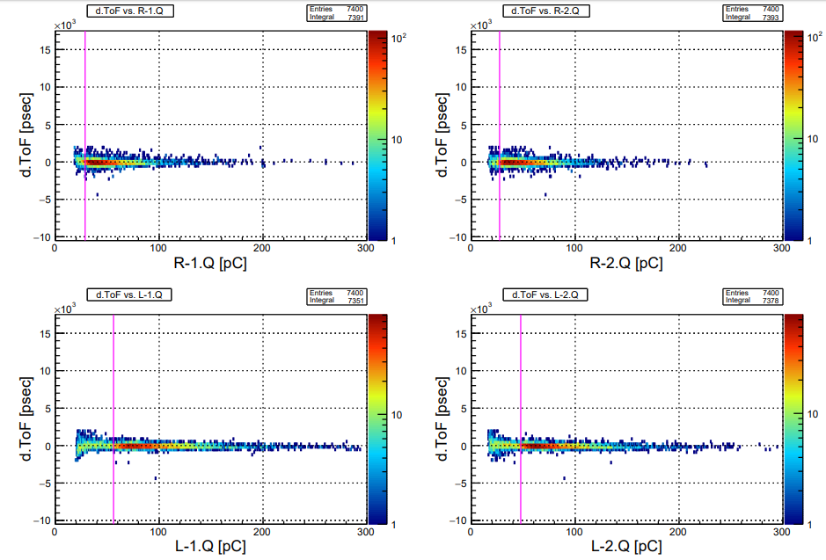
run059

Slide 20
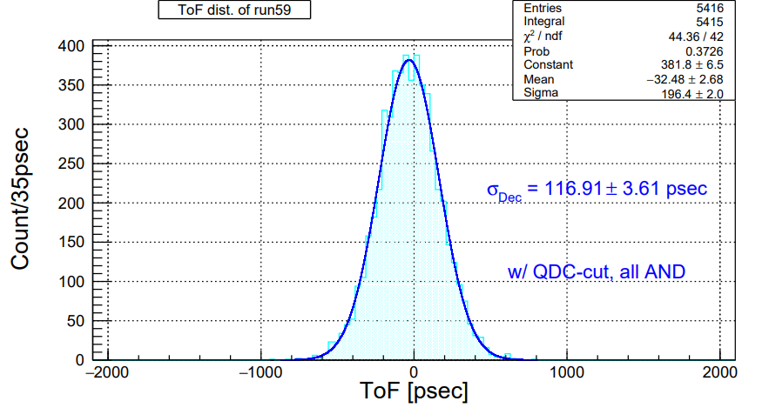
run059

Slide 21
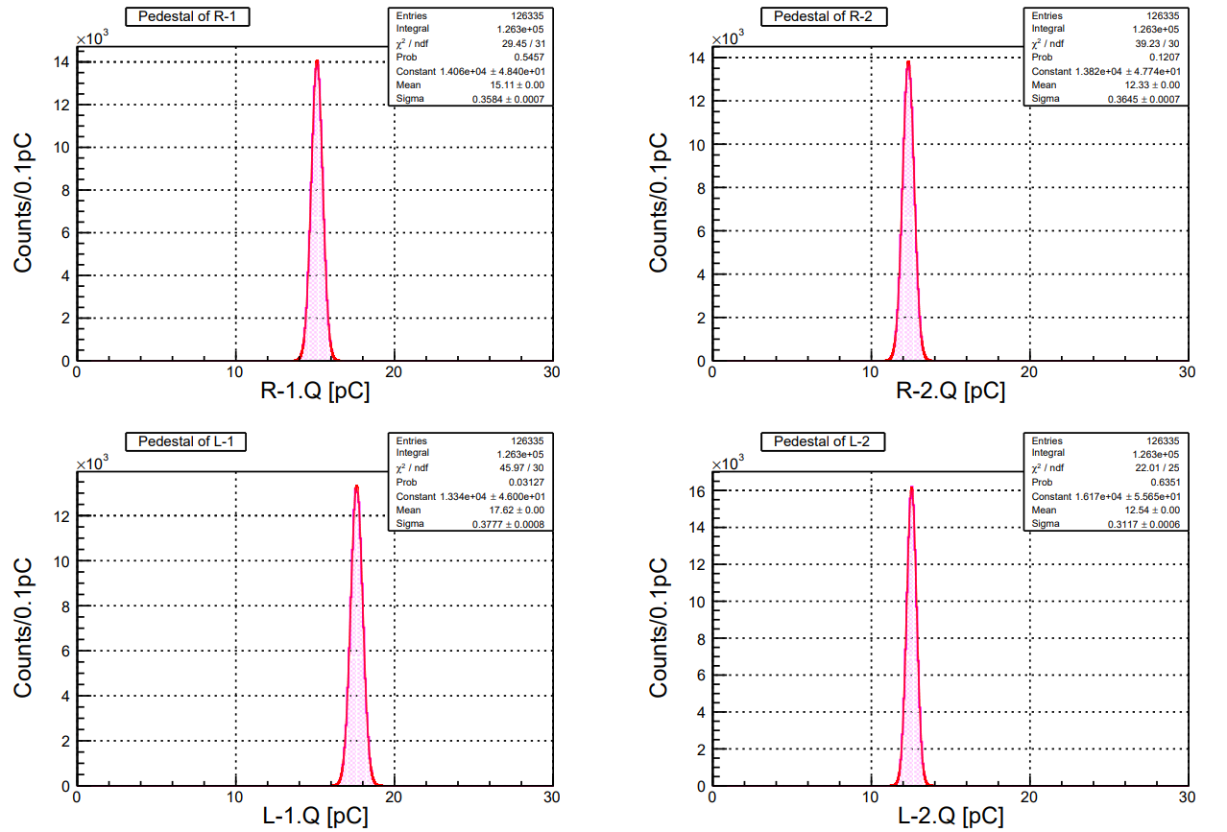
run061

Slide 22
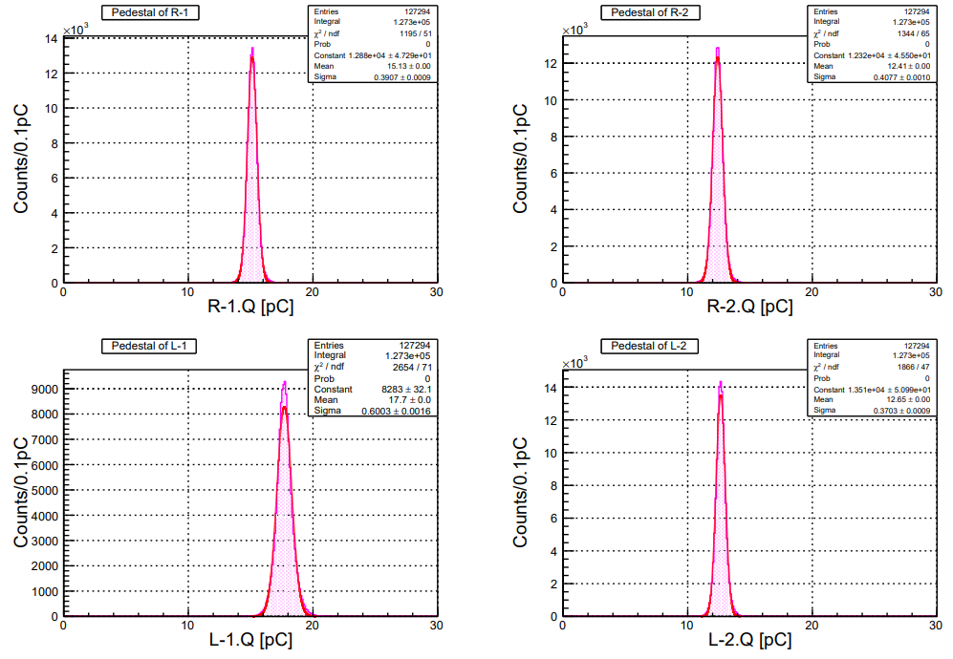
run063

Slide 23
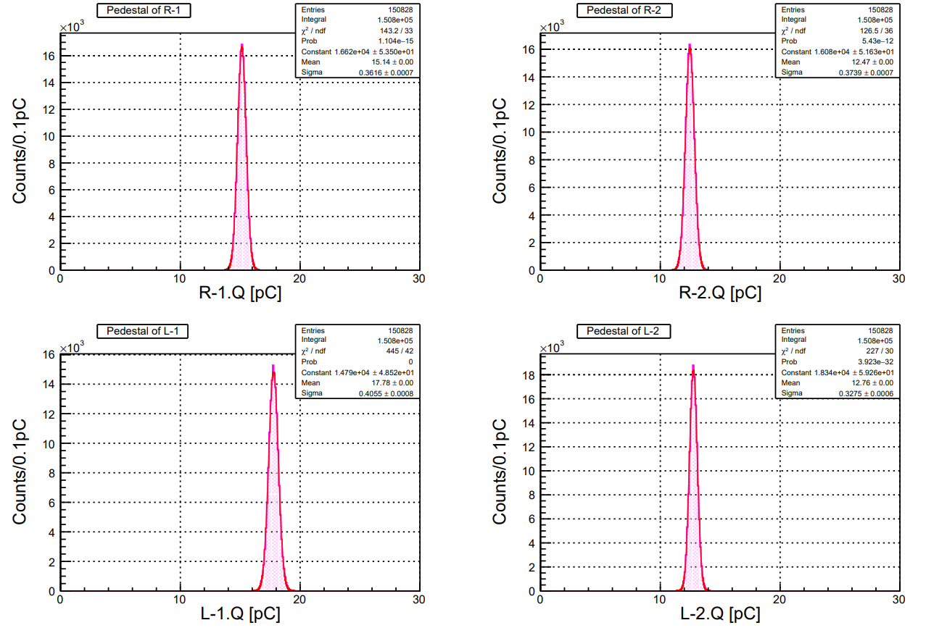
run065 (V_{b} = 44.7 V)

Slide 24
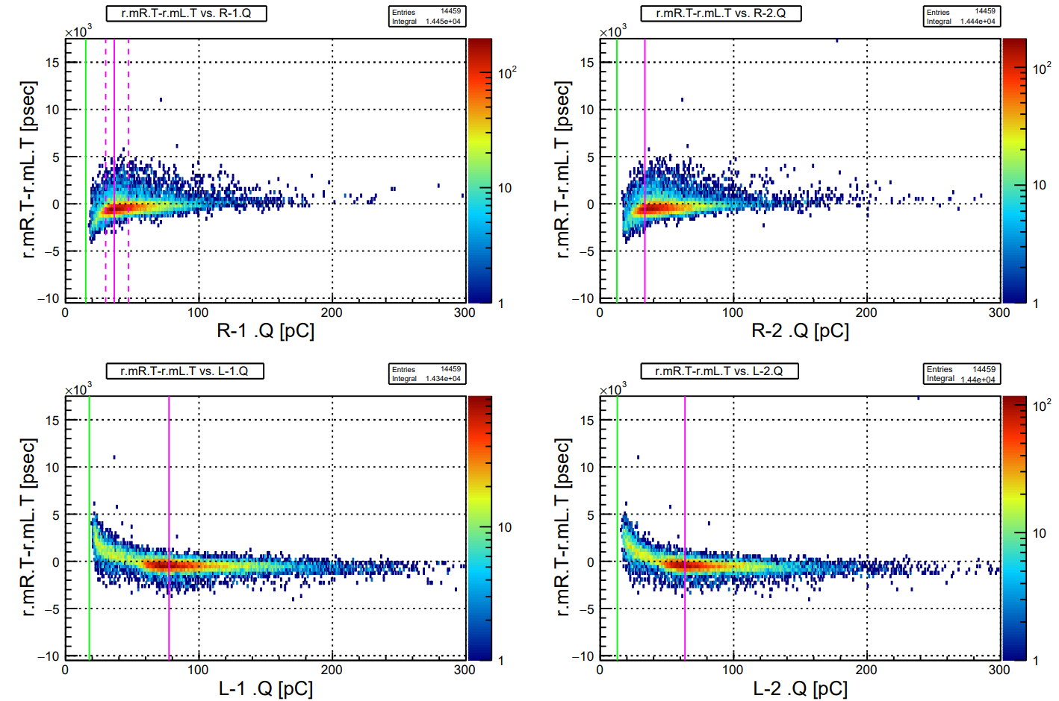
run065 (V_{b} = 44.7 V)

Slide 25
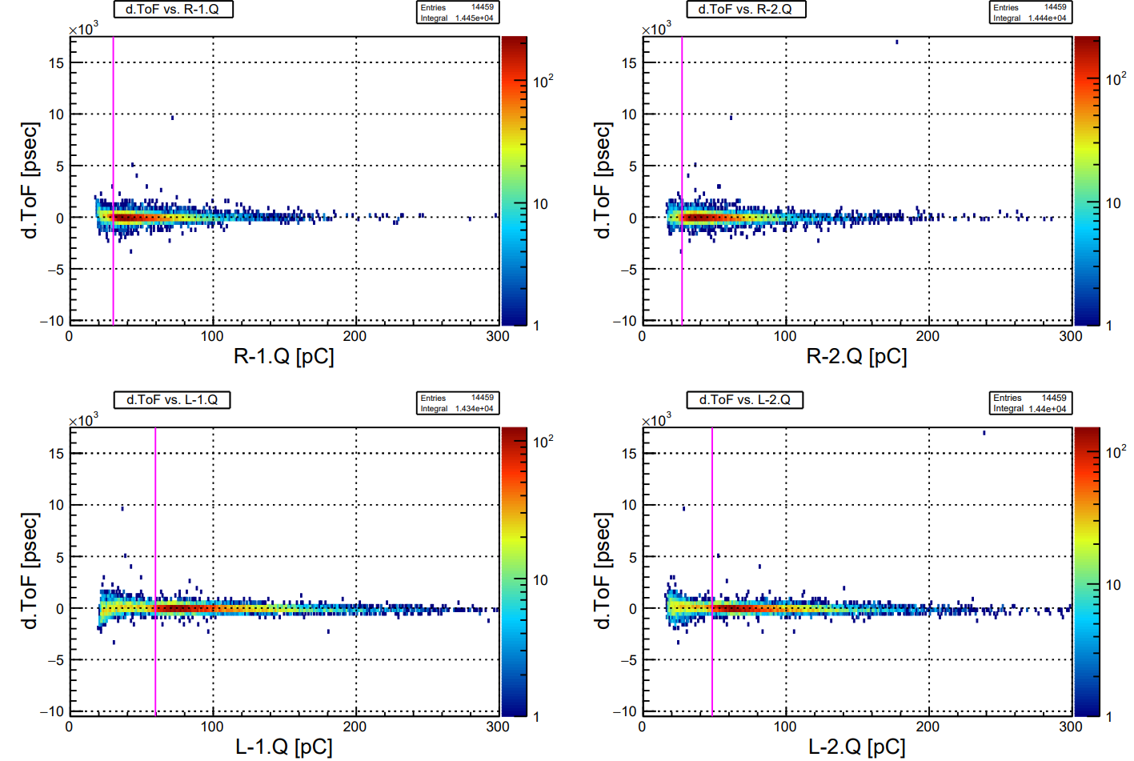
run065 (V_{b} = 44.7 V)

Slide 26
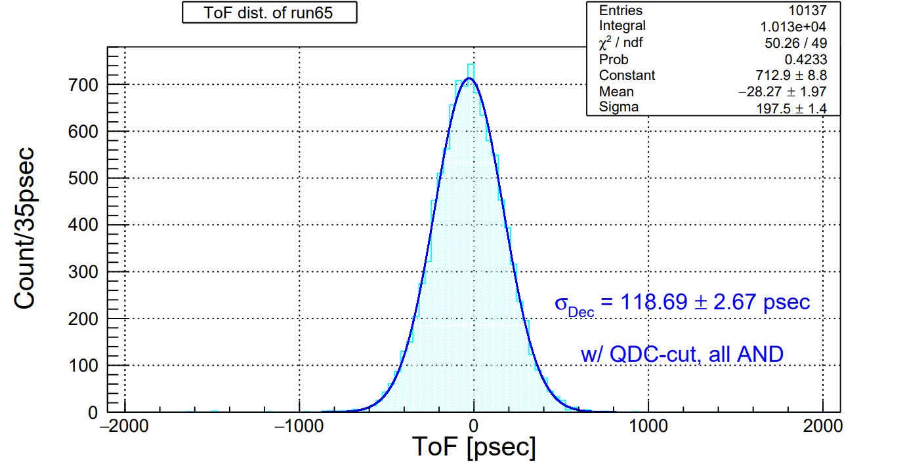
run065 (V_{b} = 44.7 V)

